Slide 1
Chapter Four
Quality Attributes

Slide 2
Quality attributes
Software quality attributes are measurable or testable properties of a software system used by quality architects.
These properties help to determine whether the software satisfies the stakeholders' requirements and needs.
quality of software systems;
how design affects software quality;
quality attributes of software design.
System quality attributes
Business quality attribute
Architecture quality attributes

Slide 3
System quality attributes
The most important software architecture quality attributes are
Usability
The customers ability to get work done with the system in an efficient and pleasing manner
how easy it is to the user to accomplish the desire task
Not require new or unique knowledge to use the system
Learnability, attractiveness, understandability
Availability
It’s ready to carry out its task when you need it to be
Concerned with the probability that the system will be operational when needed

Slide 4
System quality attributes
Performance
Concerned with how long it takes the system to respond when an event occurs
The ability of software to meet timing requirement
Security
The ability of system protect data and information from authorized access while still providing access to people and systems that are authorized
Concerned with the systems ability to withstand attacks/threats

Slide 5
System quality attributes
Modifiability
The easy with which software can deal with changes
Interoperability
The ability of software or different software's exchange information

Slide 6
System quality attributes
Testability
Concerned with the ease with which the software can be made to demonstrate its faults
Reusability
Using component in other component with small or no change

Slide 7
Business Quality Attributes
Are business quality goals
Has influence on system architecture
Related with cost, schedule, marketing
Includes :
Time to market
It relates to the time taken to implement the system
Reduce the average time required to deliver the system
Achieved by:
Reuse existing system artefacts
Use COTS (Commercial Off-the-Shelf ) component- “one size fits all” default capabilities to organizations

Slide 8
Business Quality Attributes cont’d
Cost
Time and budget are probably the constraints that most software developers are familiar with, often because there’s not enough of either
Perform cost feasibility analysis
Highly flexible architecture cost high than rigid one however maintenance cost will reduced
Projected lifetime
Related with the lifespan of the software system

Slide 9
Business Quality Attributes cont’d
Extending the lifetime of the system
Make the product to survive longer in market place
Achieved by:
Develop software that is scalable, modifiable and portable
Targeted market
To attack large market with a collection of related product
Maintain competitive advantage
Achieved by:
Consider the quality attributes such as portability, functionality, performance, reliability and usability of product

Slide 10
Business Quality Attributes cont’d
Read about
Roll-out schedule
Integration with legacy system

Slide 11
Architecture quality attributes
Conceptual Integrity
combining the components and their interactions
The architecture should do similar things in similar ways
Correctness and Completeness
concerned with checking the architecture for errors and omissions
Buildability
concerned with the organization’s capabilities to actually construct the architecture in question

Slide 12
Achieving Qualities (Tactics)
The quality attribute requirements specify the responses of the system that, with a bit of luck and a dose of good planning, realize the goals of the business.
now turn to the techniques an architect can use to achieve the required quality attributes. these techniques architectural tactics.
A tactic is a design decision that influences the achievement of a quality attribute response-tactics directly affect the system’s response.
A system design consists of a collection of decisions. Some of these decisions help control the quality attribute responses; others ensure achievement of system functionality.

Slide 13
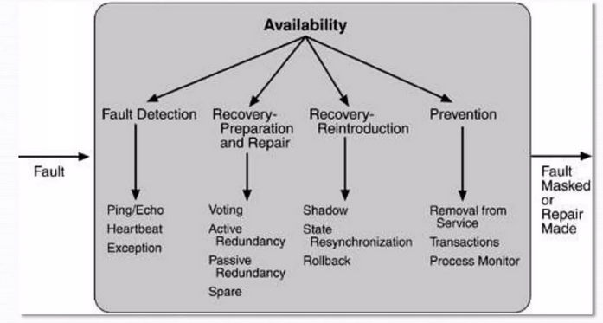
Cont…
Availability Tactics

Slide 14
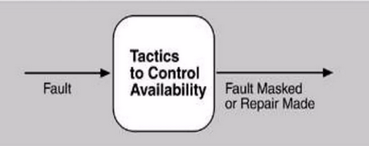
Cont…
A tactic is a design decision that influences the control of a quality attribute response.
represent the relationship between stimulus, tactics, and response,
The tactics, like design patterns, are design techniques that architects have been using for years.
Goal of availability tactic

Slide 15
Group Assignment
Read about quality attributes of ISO 9126 and ISO 25010 quality models
Discuss how each of the quality attributes can be achieved
Determine the concerns for each of the quality attributes
Identify and discuss conflicting quality attributes

